Slide 1
Fine-Grained Controllable Story Generation with Characters, Actions, and Emotions
-Anusha Gangasani

Slide 2
Introduction
Reason to develop this project
CHAE model for fine-grained controllable story generation

Slide 3

Similar Works
Story Generation
Controllable Text Generation

Slide 4
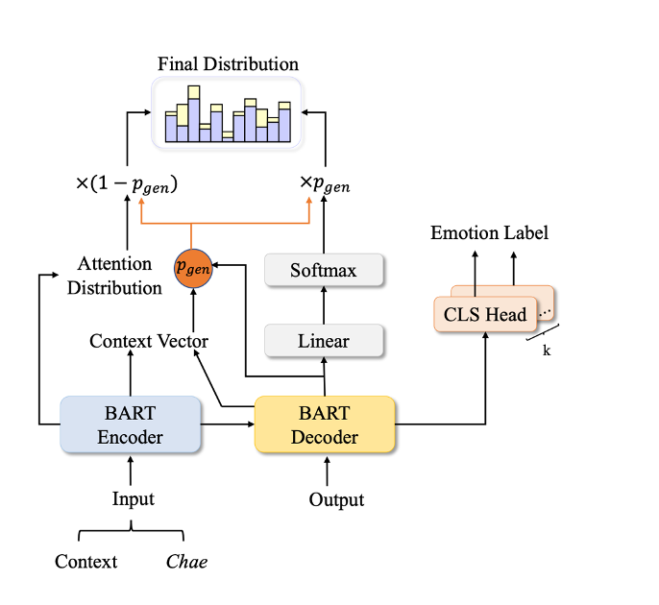
Architecture of CHAE
This job aims to generate a story where each phrase corresponds to Chae in terms of character, action, and emotion, hence improving generation quality.

Slide 5
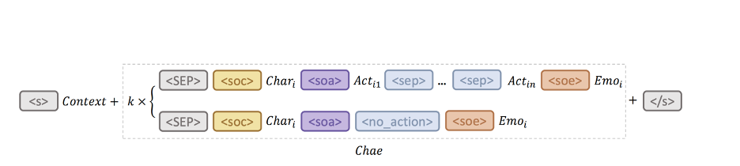
Input Form of CHAE

Slide 6
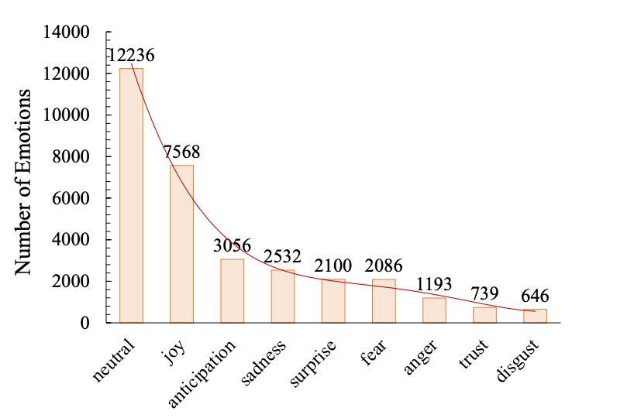
Statistics of Emotion Categories
The emotion categories present a long-tail distribution.

Slide 7
Experiment Models
GPT-2
BART
SoCP
SSG

Slide 8
Evaluation Metrics
PPL
BLEU
Distinct
Emotion Labels

Slide 9
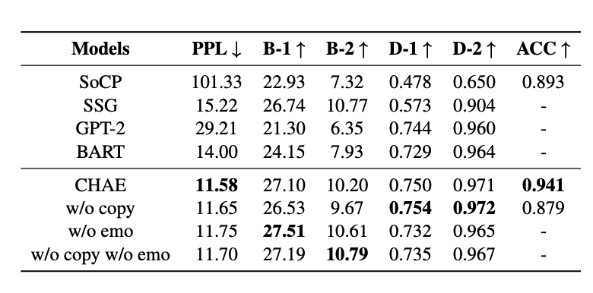
Results

Slide 10
Drawbacks
The dataset only has 5-sentence stories, which isn't enough to generate longer ones.
The model relies extensively on tagged characters, emotions, and behaviors in the dataset, but getting them is expensive.
Some Chae descriptors in the dataset aren't mirrored in the sentences.
The iterative story-generating process takes a long time and may generate a cascade problem, affecting narrative quality.

Slide 11
Future Developments
Adopt Writing Prompts and WikiPlots2 datasets.
Dynamically adjusting condition weights.
Exploring more convenient and effective training approaches.

Slide 12
Thank You

